Slide 1
The Salvation of the Soul

Slide 2
Salvation of the Soul
1 PETER
Outline

Slide 3
Salvation of the Soul
1 PETER
Salutation – 1:1-2
Preface: Salvation of the Soul, Our Hope and Goal – 1:3-12
Body: Salvation of the Soul, Worked out in Experience – 1:13 – 4:19
Epilogue and Conclusion – 5:1-14

Slide 4
Salvation of the Soul
1 PETER
Preface: Salvation of the Soul, Our Hope and Goal - 1:3-12
The Nature of Our Salvation - 1:3-5
The Joy of Our Salvation - 1:6-9
The Appeal of Our Salvation - 1:10-12
Notes:
The Nature of Our Salvation explains what God has done giving us a glorious inheritance, the opportunity of very rich future, which is secure by God’s power and trust.
The Joy of Our Salvation describes our salvation and what we do. We are to exalt in our future inheritance despite current sufferings, knowing that our faith is being purified for future glory, which is the salvation of our soul, the total transforming work of God in our lives.
The Appeal of Salvation describes what the prophets did and what the angels would like to do by sharing in the sufferings and the glory of the Messiah, and the Messianic age.

Slide 5
Salvation of the Soul
1 PETER
Our goal, the end of our faith, is the salvation of the soul which is the total transforming work of God upon our lives, which is presently being realized in the midst of Christ like suffering, and which in the future will be unveiled in Christ like glory at His Coming.

Slide 6
Salvation of the Soul
1 PETER
Body: Salvation of the Soul,
Worked Out in Experience
1:13-21
Notes:
The body of the letter describes the salvation of the soul as it is worked out in our current experience, our brief stay as sojourners in this evil age.

Slide 7
Salvation of the Soul
1 PETER
Body: Salvation of the Soul, Worked out in Experience – 1:13 – 4:19
In Relation:
to God – 1:13-21
to Brethren – 1:22 – 2:10
to the World – 2:11 – 3:7
to Life Itself – 3:8 – 4:6
to the Consummation of History – 4:7-19

Slide 8
Salvation of the Soul
1 PETER
Body: Salvation of the Soul, Worked out in Experience – 1:13 – 4:19
In Relation:
to God – 1:13-21
Through Obedience – 1:13-16
Through Fear – 1:17-21
Notes:
First Peter describes how the salvation of the soul is worked out in our lives in relationship to God through obedience to God and through fear of God.

Slide 9
Salvation of the Soul
1 PETER
In Relation to the Brethren - 1:22 – 2:10
Parent-child Relationship
Brother-to Brother Relationship
Notes:
The next most intimate and crucial area of life and experience after the Parent-child relationship is that of the brother-to-brother relationship. Both of these relationships are established when we become born again into the family of God, becoming children of God by faith.

Slide 10
Salvation of the Soul
1 PETER
Body: Salvation of the Soul, Worked out in Experience – 1:13 – 4:19
In Relation:
to the Brethren – 1:22 – 2:10
Through Constant Love – 1:22-25
Through Collective Growth, as God’s Chosen People – 2:1-10

Slide 11
Salvation of the Soul
1 PETER
In Relation to the Brethren - 1:22 – 2:10
Through Constant Love – 1:22-25

Slide 12
Salvation of the Soul
1 PETER
In Relation to the Brethren - 1:22 – 2:10
“Since you have purified your souls in obeying the truth through the Spirit in sincere love of the brethren, love one another fervently with a pure heart,” (1:22)

Slide 13
Salvation of the Soul
1 PETER
In Relation to the Brethren - 1:22 – 2:10
The State - “Since you have purified your souls”
The Means - “in obeying the truth through the Spirit”
The Purpose – “in sincere love of the brethren”
The Command - “love one another fervently with a pure heart”
Notes:
What – Our souls have been made pure.
Who - You
How and When – Our souls were made pure through the Spirit (the Agent)
when we obeyed the truth.
For what Reason – So that we may love the brethren deeply and consistently.

Slide 14
Salvation of the Soul
1 PETER
In Relation to the Brethren - 1:22 – 2:10
The Reason - “having been born again, not of corruptible seed but incorruptible, through the word of God which lives and abides forever,” (1:23)
The word of God like our seed, the new nature, is imperishable; it regenerates, gives life, and nurtures, yet the word remains unchanged.
Notes:
Why – the reason why we should love the brethren sincerely and consistently is because our new nature itself is pure and undefiled, not corruptible. Our outward love ought to be just as consistent as our new inner nature and just as consistent as the word of God, never fading or diminishing, but endures.

Slide 15
Salvation of the Soul
1 PETER
In Relation to the Brethren - 1:22 – 2:10
The Reason - “having been born again, not of corruptible seed but incorruptible, through the word of God which lives and abides forever,” (1:23)
God provides the imperishable and incorruptible new nature, the inner self, through the Word, when we obey the truth, believing in Him for eternal life.

Slide 16
Salvation of the Soul
1 PETER
In Relation to the Brethren - 1:22 – 2:10
The Reason - “having been born again, not of corruptible seed but incorruptible, through the word of God which lives and abides forever,” (1:23)
“Whoever has been born of God does not sin, for His seed remains in him; and he cannot sin, because he has been born of God.” (1 John 3:9) -- [Inner Self]

Slide 17
Salvation of the Soul
1 PETER
In Relation to the Brethren - 1:22 – 2:10
“All flesh is as grass, and all the glory of man as the flower of the grass. The grass withers, and its flower falls away, but the word of the Lord endures forever. [Isaiah 40:6-8]
Now this is the word which by the gospel was preached to you.” (1:24-25)
Notes:
Our love should not be like the grass that withers or like the flower that fades, but our love for God and the brethren ought to be like the word of God that eternally endures.
This is the same constant and enduring word, the good news, that they heard preached to them initially and by which they believed and were saved. We look to the word as our guarantor of the promise of eternal life, that proceeds from a God who cannot lie.

Slide 18
Salvation of the Soul
1 PETER
In Relation to the Brethren - 1:22 – 2:10
“Since you have purified your souls” (1:22a)
“purified” – the believer is an active participate in the purification of the soul.
“purified” – “the act of making oneself clean and pure before God.” [Nelson Bible Dictionary]
Notes:
Since we have purified our souls we are able to love our brothers.

Slide 19
Salvation of the Soul
1 PETER
In Relation to the Brethren - 1:22 – 2:10
“Since you have purified your souls” (1:22a)
“purified” – In the OT there were laws concerning ceremonial purifications. But there are none in the NT.
Notes:
Mosaic Law provided instruction for purification rights in three categories of uncleanness – leprosy, sexual discharge, and contact with a dead body.
Since we have purified our souls we are able to love our brothers.

Slide 20
Salvation of the Soul
1 PETER
In Relation to the Brethren - 1:22 – 2:10
“Since you have purified your souls obeying the truth through the Spirit” (1:22)
“You ran well. Who hindered you from obeying the truth? This persuasion does not come from Him who calls you.” (Gal. 5:7-8)
Notes:
The means by which we were purify ourselves is by obeying the truth.
“I marvel that you are turning away so soon from Him who called you in the grace of Christ, to a different gospel,” (Gal 1:6-7) They did well at first, but now they were listening to those who had tricked them into believing in a gospel that was not by grace, but added keeping the Mosaic Law as an further requirement.
These troublers had now persuaded the Galatians from not trusting and obeying in the command to believe in Christ by faith alone for eternal life.
“O foolish Galatians! Who has bewitched you that you should not obey the truth” (Gal 3:1) “Are you so foolish? Having begun in the Spirit, are you now being made perfect by the flesh?” (Gal 3:3)

Slide 21
Salvation of the Soul
1 PETER
In Relation to the Brethren - 1:22 – 2:10
“Not everyone who says to Me, 'Lord, Lord,' shall enter the kingdom of heaven, but he who does the will of My Father in heaven…” (Matt 7:21-23)
It is the Father’s will that we believe in Jesus for eternal life (Jn. 1:13; also see 4:34f; 5:30)
Notes:
The means by which we purify ourselves is by believing in Jesus which is also the will of the Father.
"Not everyone who says to Me, 'Lord, Lord,' shall enter the kingdom of heaven, but he who does the will of My Father in heaven. Many will say to Me in that day, 'Lord, Lord, have we not prophesied in Your name, cast out demons in Your name, and done many wonders in Your name?' And then I will declare to them, 'I never knew you; depart from Me, you who practice lawlessness!” (Matt 7:21-23)
The phrase “the will of My Father”, the Father’s will, or “the will of the One who sent Me” is used 16 times in the Gospels… each time the phrase or its equivalent it is used in the presence of unbelievers (i.e. evangelistic setting) and its always refers to believing on Jesus for eternal life.” When a repeated word of phrase is repeatedly used in the exact same way in the same contexts… it is understood as a ‘technical use’.” (Steve Elkins, Keys to Kingdom Greatness, Coppell, TX. 2014. p. 397-398.
It is the Father’s will that we believe in Jesus for eternal life (Jn. 1:12-13) It is the Father’s will for people to be won to faith and believe Jesus for eternal life (Jn. 4:34f).

Slide 22
Salvation of the Soul
1 PETER
In Relation to the Brethren - 1:22 – 2:10
“This is the will of the Father who sent Me, that of all He has given Me I should lose nothing, but should raise it up at the last day. And this is the will of Him who sent Me, that everyone who sees the Son and believes in Him may have everlasting life; and I will raise him up at the last day.” (Jn. 6:39-40)

Slide 23
Salvation of the Soul
1 PETER
In Relation to the Brethren - 1:22 – 2:10
“And this is His commandment: that we should believe on the name of His Son Jesus Christ…” (1 John 3:23)
If we keep His commandment, the will of the Father, to believe in Jesus for eternal life, then we are obeying the truth through the Spirit.

Slide 24
Salvation of the Soul
1 PETER
Metaphors for Believing
“Looking” (Jn. 3:14-15)
“Obeying the truth”
(1 Pt. 1:22; Gal. 5:7)
“Hearing” (Jn. 10:16, 27)
“Entering” (Jn. 10:7-8)
“Doing the will of My
Father” (Mt. 7:21;
Jn. 1:13; 4:34; 5:30;
6:39-40)
“Drinking” (Jn. 4:14)
“Coming” (Jn. 5:40, 6:37, 7:37)
“Receiving” (Jn. 1:12)

Slide 25
Salvation of the Soul
1 PETER
In Relation to the Brethren - 1:22 – 2:10
“Since you have purified your souls in obeying the truth through the Spirit,” (1:22)
You were regenerated, your souls made clean by the obedience of faith accomplished through the Spirit.

Slide 26
Salvation of the Soul
1 PETER
In Relation to the Brethren - 1:22 – 2:10
“in sincere love of the brethren, love one another fervently with a pure heart,” (1:22)
The two adverbial expressions “fervently” or “deeply” and “from the heart” conveys the extent and the seriousness of love.
Notes:
The purpose of our purification is that we might love the brethren sincerely.

Slide 27
Salvation of the Soul
1 PETER
In Relation to the Brethren - 1:22 – 2:10
“having been born again, not of corruptible seed but incorruptible, through the word of God which lives and abides forever,” (1:23)
Why love one another?
You have been born again!
Notes:
Why should we love one another? “Because you have been born again.” The Spirit is the active agent who regenerates and creates the seed, the new sinless nature. The unbeliever is the one who causes this to occur receiving the incorruptible seed by the means of faith, obeying the truth, which he is both able and responsible to do.
We have no part in the basis of our salvation, God alone makes salvation possible through the death and resurrection of Jesus Christ.
Our spiritual birth occurred in the past and has lasting and eternal significance for the present and the future.

Slide 28
Salvation of the Soul
1 PETER
In Relation to the Brethren - 1:22 – 2:10
“All flesh is as grass, and all the glory of man as the flower of the grass. The grass withers, and its flower falls away, but the word of the Lord endures forever.” (1:24-24; Isaiah 40:6-8)
Notes:
“He is the living God and he endures forever” (Daniel 6:26) Don’t let your love for one another be short-lived, illustrated and contrasted by the metaphor of temporal grass and flowers with the continues word of God.

Slide 29
Salvation of the Soul
1 PETER
Preface: Salvation of the Soul,
Our Hope and Goal – 1:3-12
Body: Salvation of the Soul, Worked out
in Experience – 1:13 – 4:19

Slide 30
Salvation of the Soul
1 PETER
In Relation to God - 1:22 – 2:10
Through Obedience – 1:13-16
Through Fear – 1:17-21
In Relation to the Brethren - 1:22 – 2:10
Through Constant Love – 1:22-25
Through Collective Growth as God’s Chosen People – 2:1-10

Slide 31
Salvation of the Soul
1 PETER
In Relation to the Brethren - 1:22 – 2:10
Through Collective Growth as God’s Chosen People – 2:1-10
With a Spiritual Appetite for the Pure Milk of the Word – 2:1-3
With an Understanding of the Magnificence of Our Privilege – 2:4-5

Slide 32
Salvation of the Soul
1 PETER
In Relation to the Brethren - 1:22 – 2:10
Through Collective Growth as God’s Chosen People – 2:1-10
With an Understanding of the Magnificence of His Person – 2:6-8
With an Understanding of the Magnificence of Our Purpose – 2:9-10

Slide 33
Salvation of the Soul
1 PETER
In Relation to the Brethren - 1:22 – 2:10
Through Collective Growth – 2:1-10

Slide 34
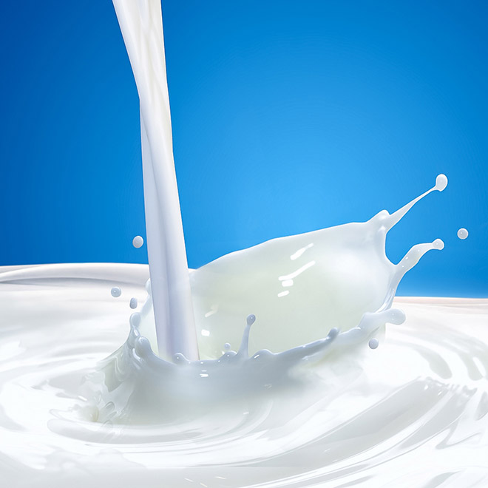
Salvation of the Soul
1 PETER
In Relation to the Brethren - 1:22 – 2:10
With a Spiritual Appetite for the Pure Milk of the Word – 2:1-3
Notes:
The salvation of the soul is worked out in relationship to the brethren through collective growth as God’s chosen people with a spiritual appetite of God’s word just as new born babies desire milk from their mothers.

Slide 35
Salvation of the Soul
1 PETER
In Relation to the Brethren - 1:22 – 2:10
“Therefore, laying aside all malice, all deceit, hypocrisy, envy, and all evil speaking,” (2:1)
We must put aside all that is inconsistent with the love which we have for one another.
Notes:
Before we can desire to the word we must first lay aside our evil attitudes. If love is the true goal of the purified soul – a love which is steadfast and enduring like God’s word. then we must put aside all that is inconsistent with it.

Slide 36
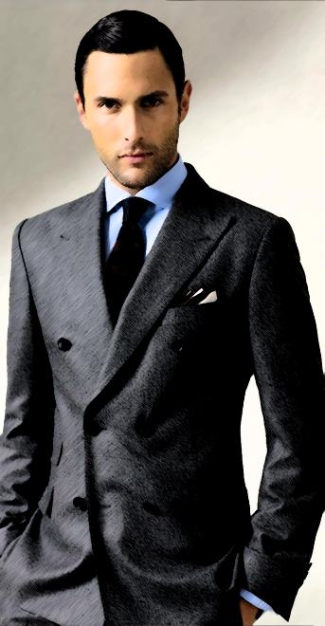
Salvation of the Soul
1 PETER
In Relation to the Brethren - 1:22 – 2:10
“Therefore, laying aside all malice, all deceit, hypocrisy, envy, and all evil speaking,” (2:1)
A well dressed Christian does not wear these dirty cloths. They went out of style when we were born anew.
Notes:
Peter tells his readers not to fight against these evils but to “lay them aside”, literally, to take off clothing. “Are we a spiritually stylish Christian? Do we wear the new clothing of a new life, or the filthy rags of a bygone day?” (Hodges, p. 38)
“But now you also, put them all aside: anger, wrath, malice, slander, and abusive speech from your mouth. Do not lie to one another, since you laid aside the old self with its evil practices, and have put on the new self who is being renewed to a true knowledge according to the image of the One who created him –” (Colossians 3:8-11)

Slide 37
Salvation of the Soul
1 PETER
In Relation to the Brethren - 1:22 – 2:10
“malice” – a general word for evil, implying a mean or unkind attitude toward others.
“deceit” – lying with trickery; to deliberately mislead; to use a decoy; to con or to scam.

Slide 38
Salvation of the Soul
1 PETER
In Relation to the Brethren - 1:22 – 2:10
“hypocrisy” – to act out a artificial part; to fake -- pretender; to be insincere.
“envy” – having negative and hateful attitude towards others.
“evil speaking” – slanderous speech that belittles or vilifies another.

Slide 39
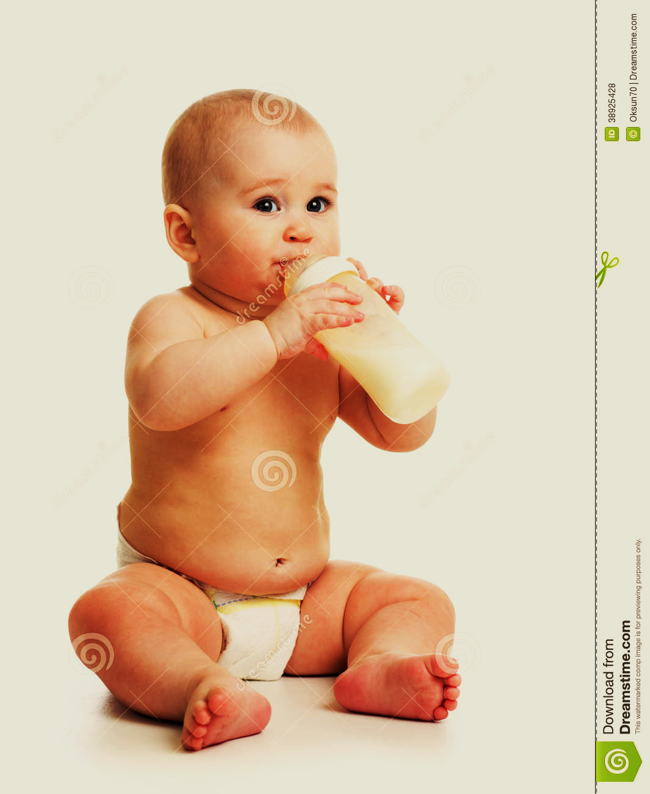
Salvation of the Soul
1 PETER
In Relation to the Brethren - 1:22 – 2:10
“as newborn babes, desire the pure milk of the word, that you may grow thereby, (2:2)
“pure” – “adolos” - undeceitful; sincere; contrasted with the deceitful mind of vs. 1.
Notes:
Peter now uses a simile of a new born baby. We are to be like a new born baby because new born desperately desire their mother’s milk. This is not to suggest that the readers were new believers. It suggest an eagerness and longing for the word just as a newborn baby eagerly desires his milk.

Slide 40
Salvation of the Soul
1 PETER
In Relation to the Brethren - 1:22 – 2:10
“as newborn babes, desire the pure milk of the word, that you may grow thereby, (2:2)
“word” – “logikon” – that which is logical; what pertains to the rational faculty of man.
Notes:
The “word” is “logikon” what is logical. It pertains to the rational faculty of man. And it is also a reference to what is spiritual, that is, not literal. “God’s Word is a kind of spiritual and non-literal milk which feeds man on the level of his mental and rational faculties.” (Hodges, p. 39)

Slide 41
Salvation of the Soul
1 PETER
In Relation to the Brethren - 1:22 – 2:10
“as newborn babes, desire the pure milk of the word, that you may grow thereby, (2:2)
“grow” – to increase; to enlarge; Craving God’s Word has a purpose: not simply to know more of it, but to grow up or mature spiritually.
Notes:
It has the purpose of giving us a better understanding of the Word.
“We proclaim Him, admonishing every man and teaching every man with all wisdom, so that we may present every man complete in Christ. For this purpose also I labor…” (Col. 1:28-29) [NASU]

Slide 42
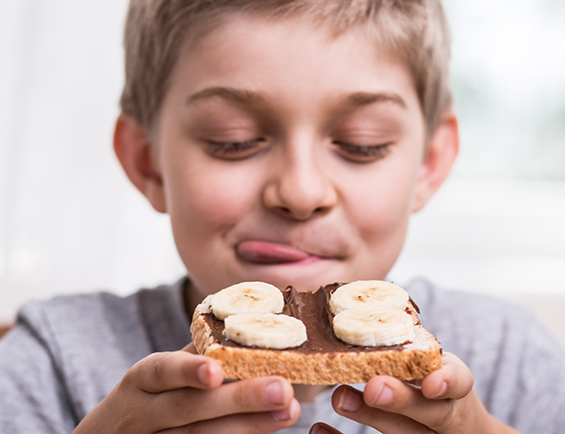
Salvation of the Soul
1 PETER
In Relation to the Brethren - 1:22 – 2:10
“if indeed you have tasted that the Lord is gracious.” (2:3)
“gracious” – good or kind; It assumes the readers have indeed experienced
the goodness of the Lord.
Notes:
“Taste and see that the Lord is good.” (Psalm 34:8)
“Desire for God’s Word hinges on our taste of God’s goodness to us in Christ.” If we had never believed that the Lord was good we would have never trusted in Him for eternal life. Why would He gives us the gift of eternal life if He was not good? The rich young ruler ask Jesus how he may obtain eternal life because he believe he was a good teacher.
The Lord is good and he is always good, even when times are tough, when various trials tests our patience. We may introduce the idea that God is not always good, but even possibly evil. But James says, “Do not be deceived, my beloved brethren. Every good gift and every perfect gift is from above, and comes down from the Father of lights, with whom there is no variation or shadow of turning.” (James 1:16-18) God is eternally good. There is never a time when He is not.

Slide 43
Salvation of the Soul
1 PETER
In Relation to the Brethren - 1:22 – 2:10
“if indeed you have tasted that the Lord is gracious.” (2:3)
“gracious” – What follows in verses 4-10 is a long and extremely rich doctrinal
exposition of that goodness to us
collectively, that is, with the Church.
Notes:
“In context, Peter is thinking about the assembly where the “spiritual milk” is ministered to us. If we are to properly desire the milk we must lay aside those attitudes of spirit which creates friction and ill will toward the brethren, and we must concentrate on God’s rich grace and goodness to us. An assembly filled with malice, envy and such like will not be able to grow properly through ministry or the Word.” (Hodges, p. 40)

Slide 44
Salvation of the Soul
1 PETER
Conclusion

